Slide 1


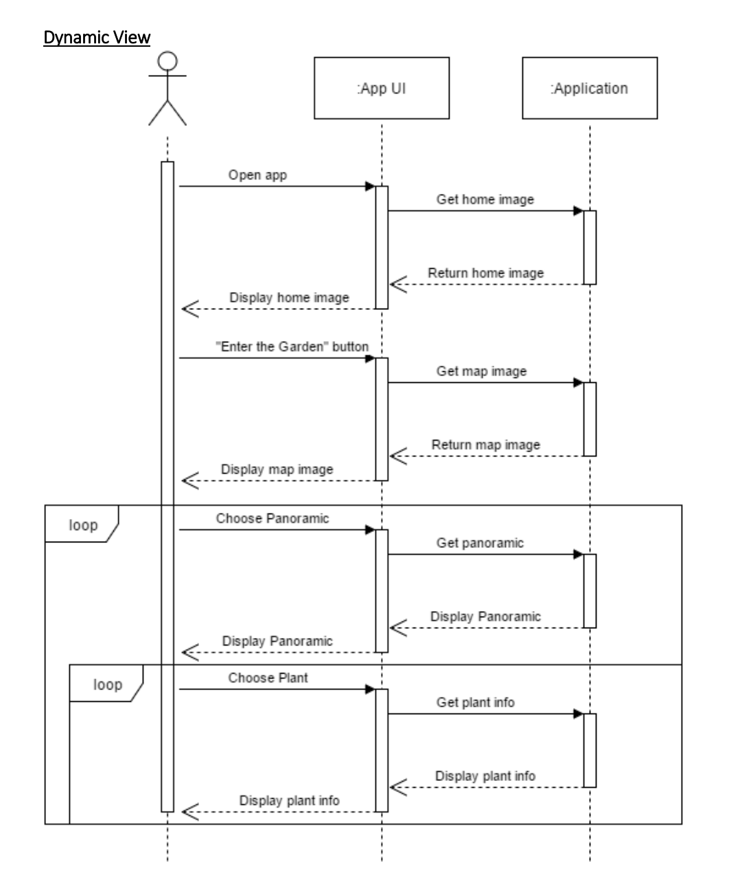
Creation of a Botanical Garden Application
Justin Le, Bryson White, Sam Watson, Trevor Artz
Department of Computer Science
University of North Carolina at Charlotte
1. Project Overview
2. Dynamic Design:
3. Prototype
Conclusions
The botanical garden staff are attempting to address two particular needs they have in the garden. Currently, the gardens have plaques to display the names of the plants to their visitors. However, this method requires someone to maintain the plaques and having the physical objects present appear pervasive. In addition, what the staff would really be pleased with attracting some more visitors to the garden. Both of these issues call for an efficient software solution, in which the garden can be enjoyed to it’s fullest.
Participatory Sensing Framework
Captures of our Prototype:
The state of our Project:
In conclusion, the state of our project at this point is refinement, as well as a few additions. We have through our tribulations and trials succeeded to get the panoramic views functional and dynamic. Our refinements will mainly focus on fine tuning the user experience to be comfortable.
A participatory sensing application on the mobile phone provides features that help users to collect and submit data
Data is delivered to a server that processes and
stores results
The campaign organizer analyzes the collected data
Future Additions to the Project
Photo gallery to allow for user submitted photos of the gardens
Make an easy way for our stakeholders to add and manipulate data.
2. Problems
System Design
We first considered using a form of wireless connectivity to allow the user to be tracked throughout the garden, However, due to the overhanging trees, connection would be poor. Our proceeding thought was a more local connection or posts that used a reliable close-range connectivity since the panoramas would be in the same locations. After discussing it with the botanical garden staff, We found that only six panoramas were needed. We found that all the connectivity issues were unneeded. Navigating through six pictures wouldn’t be a hassle for the user. Altogether, we found that the smartest way of doing it would be to eliminate the dependency on a reliable outside connection and keep it all safely packed within the app.
References
Not Applicable
Features
Deployment Architecture: Runs on a single processor.
Persistent Data Storage: does not require persistent data storage.
Global Control Flow operates in a procedural fashion. The user follows a simple path to navigate through the application.
7. Acknowledgements
The Botanical Gr
Ms. Payton for the idea of User Submitted Photo Gallery

